Slide 1
Kashti 2.0
(Project Kayak)
Sponsored by Microsoft
Cody Uhi, Daniel De La O, Derryck Dunn, Spencer Sundrud, Stephen Kendall

Slide 2
Kashti 2.0 Objective Statement
“Create a secure, interactive web-based User Interface (UI) that offers full functionality for the Brigade event-driven scripting platform by May 2021.”
What is Brigade/Kashti?
Event Happens
(Pull Request Opened on GitHub,
Slack Message Received,
Image Pushed to Docker Hub)
Scripts Run
(Run a Test Suite,
Turn On Lights,
Send Email Notification)

Slide 3
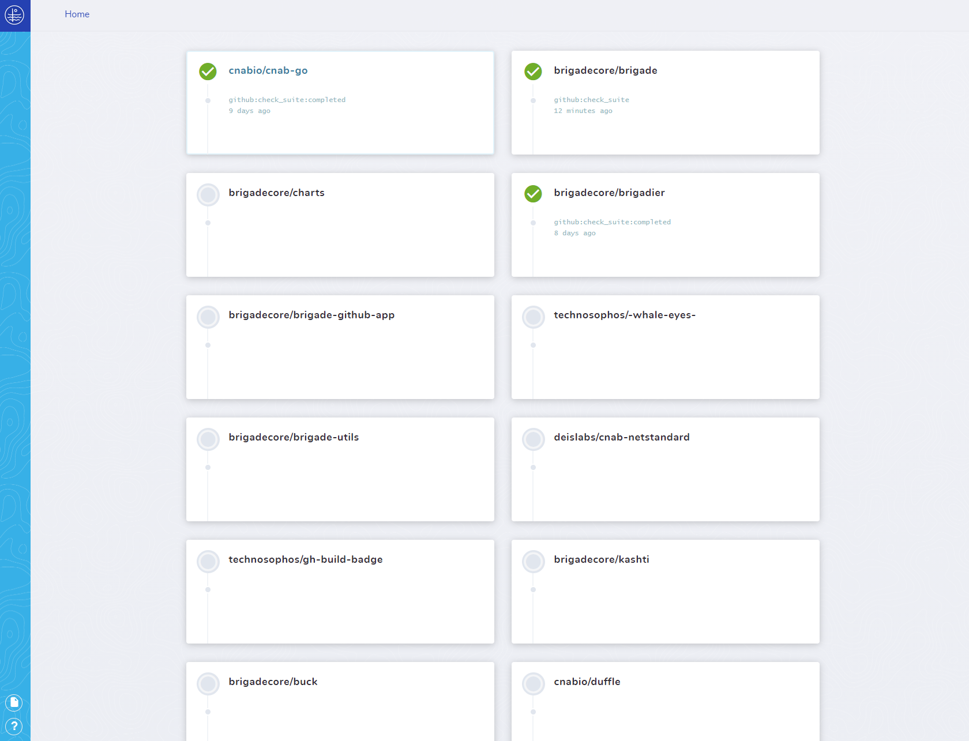
Kashti 1.0
Kashti (brigadecore.github.io)

Slide 4
Project Architecture
Capstone Team
Microsoft
Front End
(Kashti)
Back End
(Brigade)
SDK
Projects
User login
Team collaboration
User authentication
Core
User/server connectivity
Auth requests
Scripting engine for Kubernetes
Automating tasks in the cloud
CI/CD pipelines
Static code analysis
Report generation

Slide 5
Typescript SDK
Rewrite of existing Go SDK
Provides functions to Kashti
Executes calls to the Brigade API
Benefits:
Cleans up Kashti code
Simplifies additional app development
Progress so far:
How to execute network requests
Code structure
Adding in API endpoints

Slide 6
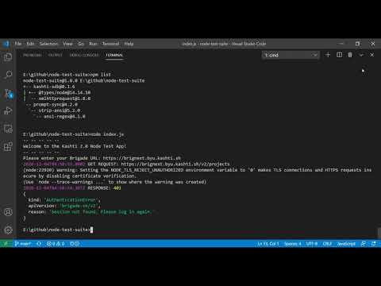
SDK Demo

Slide 7

Kashti Security Control
Primary concern - session hijacking
Solution - careful code review and penetration testing
We are researching and learning from security breaches related to Angular and TypeScript

Slide 8
Prototype Demo
link
Finished product

Slide 9
Plans For Next Semester
January February March April
Complete SDK
Verify Security
Complete UI
Package for Deployment
Deploy & Present

Slide 10

Deployment
To be done next semester
Packaged for Kubernetes

Slide 11
Time for Questions/Answers

